Slide 1






IS AI GOOD?

Slide 2



EVEN NECTAR CAN BECOME POISON IN LARGE AMOUNTS
- An old Grandmothers proverb

Slide 3
EXECUTIVE SUMMARY
AI, in its current state, remains a relatively nascent field within computer science. Although it has made substantial inroads in areas such as Tech, Advertising, Healthcare, and the Business/Finance sector (commonly referred to as the "Big 4"), its impact in Construction, Hospitality, and Transportation sectors remains relatively limited.
While there have been notable advancements in the chemical and biopharmaceutical industries, many of these breakthroughs are still in the research phase and have yet to be widely implemented.
Conversely, AI in the Big 4 industries has reached a level of maturity, with new advancements emerging daily. However, it appears that regulatory pressures stemming from the Education and Healthcare sectors could potentially hinder the current pace of progress.

Slide 4
THE DATASET
The Dataset is a collection of 200,332 articles that range from 01/01/2020 to 04/28/2023.
Its sources range from the Chicago Tribune, People.cn, News Parliament etc.
The dataset contains 5 columns: URL, Date, Language, Title, Text. An example:
URL | DATE | LANGUAGE | TITLE | TEXT
http://en.people.cn/n3/2021/0318/c90000-9830122.html | 2021-03-18 | EN | Artificial intelligence improves parking efficiency in Chinese cities - People's Daily Online | \n\nArtificial intelligence improves parking efficiency in Chinese cities - People's Daily Online\n\nHome\nChina Politics\nForeign Affairs\....
http://newsparliament.com/2020/02/27/children-with-autism-saw-their-learning-and-social-skills-boosted-after-playing-with-this-ai-robot/ | 2020-02-27 | EN | Children With Autism Saw Their Learning and Social Skills Boosted After Playing With This AI Robot – News Parliament | \nChildren With Autism Saw Their Learning and Social Skills Boosted After Playing With This AI Robot – News Parliament\n \n\nSkip to content\n\t\t\tThursday,……

Slide 5
DATA PROCESSING
The first step to processing the articles, is to effectively remove the HTML remnants. We should also ensure, to not delete contents of the article as it could affect the information within the article.
I made the decision to convert the article into a list of sentences and subsequently filtered them accordingly.
To accomplish this, I utilized spacy, a natural language processing tool, to split the text into individual sentences.
The filtering process involved selecting sentences that contained a minimal number of newlines.
The rationale behind this approach was the observation that many HTML remnants were separated by newlines, which were then combined into a single sentence by the spacy sentencizer.

Slide 6
Artificial intelligence improves parking efficiency in Chinese cities - People's Daily Online
Home
China Politics
Foreign Affairs
Opinions
Video: We Are China
Business
Military
World
Society
Culture
Travel
Science
Sports
Photo
Languages
Chinese
Japanese
French
Spanish
Russian
Arabic
Korean
German
Portuguese
Thursday, March 18, 2021
Home>>
Artificial intelligence improves parking efficiency in Chinese cities
By Liu Shiyao (People's Daily) 09:16, March 18, 2021
Photo taken on July 1, 2019, shows a sign for electronic toll collection (ETC) newly set up at a roadside parking space on Yangzhuang road, Shijingshan district, Beijing. Some urban areas of the city started to use ETC system for roadside parking spaces since July 1, 2019. (People’s Daily Online/Li Wenming)
Thanks to the application of an artificial intelligence (AI)-empowered roadside electronic toll collection (ETC) system, China’s capital city Beijing has seen significant improvement in the efficiency of parking fee collection, turnover of roadside parking spots, order in roadside parking, as well as traffic congestion.
array(["Artificial intelligence improves parking efficiency in Chinese cities\nBy Liu\xa0Shiyao (People's Daily) 09:16, March 18, 2021\nPhoto taken on July 1, 2019, shows a sign for electronic toll collection (ETC) newly set up at a roadside parking space on Yangzhuang road, Shijingshan district, Beijing.",
'Some urban areas of the city started to use ETC system for roadside parking spaces since July 1, 2019.',
'(People’s Daily Online/Li Wenming)\n\n\t',
'Thanks to the application of an artificial intelligence (AI)-empowered roadside electronic toll collection (ETC) system, China’s capital city Beijing has seen significant improvement in the efficiency of parking fee collection, turnover of roadside parking spots, order in roadside parking, as well as traffic congestion.\n\n\t’,]

Slide 7
array(["Artificial intelligence improves parking efficiency in Chinese cities\nBy Liu\xa0Shiyao (People's Daily) 09:16, March 18, 2021\nPhoto taken on July 1, 2019, shows a sign for electronic toll collection (ETC) newly set up at a roadside parking space on Yangzhuang road, Shijingshan district, Beijing.",
'Some urban areas of the city started to use ETC system for roadside parking spaces since July 1, 2019.',
'(People’s Daily Online/Li Wenming)\n\n\t',
'Thanks to the application of an artificial intelligence (AI)-empowered roadside electronic toll collection (ETC) system, China’s capital city Beijing has seen significant improvement in the efficiency of parking fee collection, turnover of roadside parking spots, order in roadside parking, as well as traffic congestion.\n\n\t’,]
["Artificial intelligence improves parking efficiency in Chinese cities\nBy Liu\xa0Shiyao (People's Daily) 09:16, March 18, 2021\nPhoto taken on July 1, 2019, shows a sign for electronic toll collection (ETC) newly set up at a roadside parking space on Yangzhuang road, Shijingshan district, Beijing.",
'Some urban areas of the city started to use ETC system for roadside parking spaces since July 1, 2019.',
'(People’s Daily Online/Li Wenming)\n\n\t',
'Thanks to the application of an artificial intelligence (AI)-empowered roadside electronic toll collection (ETC) system, China’s capital city Beijing has seen significant improvement in the efficiency of parking fee collection, turnover of roadside parking spots, order in roadside parking, as well as traffic congestion.\n\n\t',

Slide 8
DATA PROCESSING
The next step was to clean the data.
I used the tweet-preprocess library to automatically remove URL’s, hashtags, emojis and emoticons from the article.
I also used regex to remove whitespaces like newlines etc
Looking at the data, I further noticed that some sentences, that were mainly junk, barely contained any words. I decided to remove sentences that had less than 5 tokens.

Slide 9
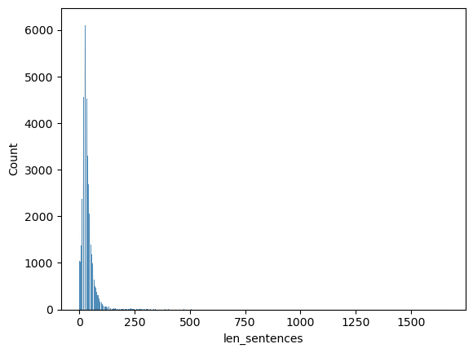
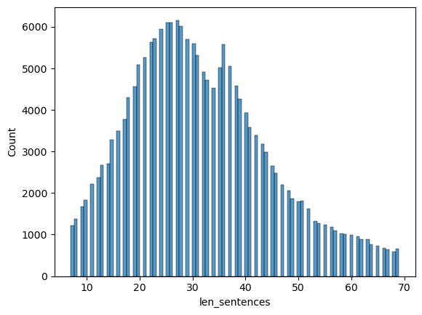
DATA PROCESSING
I then decided to have a look at the number of sentences
It was clear, that while the vast majority of sentences, centered around the range of 20-70 sentences, there were a huge number of sentences that were less than 10 sentences and more than 100 sentences. I decided that it would be best to remove articles that had less than 6 sentences and shortened the sentences to around 35 sentences.

Slide 10
DATA PROCESSING
Now that I had a relatively clean dataset, I decided to concatenate the sentences, to a single text blurb.
I also created a column with stop-words removed from the datatset.
With this I concluded my Data Preprocessing.
I continued to use my sentences, as they were very useful in batching my data.
AN EXAMPLE
Artificial intelligence improves parking efficiency in Chinese citiesBy LiuShiyao Peoples Daily 16 March Photo taken on July shows a sign for electronic toll collection ETC newly set up at a roadside parking space on Yangzhuang road Shijingshan district Beijing. Some urban areas of the city started to use ETC system for roadside parking spaces since July . Peoples Daily OnlineLi Wenming Thanks to the application of an artificial intelligence AIempowered roadside electronic toll collection ETC system Chinas capital city Beijing has seen significant improvement in the efficiency of parking fee collection turnover of roadside parking spots order in roadside parking as well as traffic congestion. As the city further deepens its roadside parking reform the ETC system has almost covered all the roadside parking spaces in the city with the proportion of vehicles parked on roads using the system exceeding percent. With the AIempowered system drivers can park their vehicles at the parking spots on the roadside and then pay the parking charge via their mobile phones after they drive away. This road used to be full of cars and even the normal lanes were occupied. You could hardly move a bit during the morning and evening commute time recalled a citizen surnamed Wang who lives in Chaoyang district of Beijing. Since the summer of roadside ETC devices have been installed here.…….

Slide 11
DATA PROCESSING
KEYWORD EXTRACTION
My first step after data pre-processing was to use the yanekyuk/bert-keyword-extractor. I was able to achieve this by feeding the dataset to the model using a Hugging Face Pipeline.
An Example of the Keywords were:
{'airtel', 'beijing', 'china', 'natural science foundation', 'odafone', 'samsung', 'smartphone'}
While the model was able to extract keywords, I had to do some further processing to get the keywords in a text form that was understandable. Because the model is a BertForTokenClassification model, the outputs were usually piece wise tokens, which had to be further stitched together.

Slide 12
DATA PROCESSING
ARTICLE FILTERING
For filtering the dataset, and Identifying articles that might not be useful, I used a simple filter to search for specific words:
isGenerative ==➔ ["generative","generation"]
isConversation ==➔ ["converasation","conversational","converse"]
isBot ==➔ ["bot","robot","robotics"]
isAutomation ==➔ ["automation","automate"]
isAI ==➔ ["ai","artificial intelligence","chatgpt","gpt"]
Post this I only selected articles that was a part of atleast one of the above filters.

Slide 13
SENTIMENT ANALYSIS
ASPECT BASED SENTIMENT ANALYSIS
While I could have used a normal sentiment analysis tool, the tool would comment on the sentiment of the data based on its overall sentiment. Thus, if the topic was not about AI, then it would risk giving a sentiment that was not related to our topic.
The solution to that was to run the data through an Aspect Based Sentiment Analyzer. I used the yangheng/deberta-v3-base-absa-v1.1 ABSA identifier.
In an Aspect Based Sentiment Analyzer, the sentiment is calculated based on a specified class.
For Example:
[CLS]The Camera was good but the battery was bad[SEP]camera[SEP] ==➔ Positive
[CLS]The Camera was good but the battery was bad[SEP]battery[SEP] ==➔ Negative
[CLS]The Camera was good but the battery was bad[SEP]food[SEP] ==➔ Neutral

Slide 14
ASPECT BASED SENTIMENT ANALYSIS
The original idea for the ABSA was to use the sentences, to calculate the overall sentiment. The algorithm was as follows:
Append the Class and the Separator tags to the sentences
Check the number of sentences
If the number of sentences is greater than 0:
Choose the first three quartiles of the sentences. As the end of the article usually does not contain much information, and mostly just junk we can remove it.
Using batch prediction, predict on the sentences, with a batch size of the length of the sentences
Calculate the proportions of the sentiments and then calculate the overall sentiment by choosing the max ratio. If the max ratio is the Neutral sentiment, we usually choose either positive or neutral sentiment if their proportions are closer to the neutral sentiment.
Append the sentiment to a list
If the number of sentences is less than 0, then we set the sentiment as Neutral.
SENTIMENT ANALYSIS

Slide 15
SENTIMENT ANALYSIS
ASPECT BASED SENTIMENT ANALYSIS
The major problem with this approach was that, I was batch inferencing on a single article, and not on multiple articles due to the sentences. Upon further testing, I discovered that the overall majority of articles were labeled as neutral itself. The approximate time of completion was 37-40 hours. Moreover since I was using a Hugging Face pipeline, It was not parallelized across two GPU’s
So I decided to use a tokenizer with a max length of 512, and batch inference directly on the dataset. Due to this, I was able to batch inference on a batch size of 10 articles, while also running on both GPU’s
Another augmentation, I tried was to also reduce the number of sentences to around 10-20 sentences for better batch inferencing.

Slide 16
INDUSTRY IDENTIFICATION
To identify Industries, I used the sampathkethineedi/industry-classification-api. Due to the models’ size, I decided to re use the code from my ABSA module to batch inference across the entire dataset. I used a batch size of 20 articles, a tokenizer with a max length of 512 and padding and truncation enabled.
The output of the model consisted of 60 classes, that I trimmed down to 21 classes.

Slide 17
INDUSTRY IDENTIFICATION
The map was
maps = {
"Advertising": ["Advertising","Interactive Media & Services", "Internet & Direct Marketing Retail"],
"Entertainment": ["Movies & Entertainment","Casinos & Gaming"],
"Retail": ["Accessories & Luxury Goods","Apparel","Apparel Retail","Leisure Products","Personal Products","Specialty Stores"],
"Tech": ["Application Software","Data Processing & Outsourced Services","IT Consulting & Other Services","Semiconductors","Systems
Software","Technology Distributors","Technology Hardware","Internet Services & Infrastructure"],
"Automotive": ["Auto Parts & Equipment","Aerospace & Defense"],
"Chemicals": ["Commodity Chemicals","Specialty Chemicals"],
"Communication": ["Communications Equipment","Integrated Telecommunication Services"],
"Construction": ["Construction & Engineering","Construction Machinery & Heavy Trucks","Homebuilding","Building Products"],
"Finance": ["Consumer Finance","Asset Management & Custody Banks","Gold","Regional Banks","Investment Banking & Brokerage","Thrifts & Mortgage
Finance"],
"Industrial": ["Diversified Metals & Mining","Industrial Machinery","Steel"],
"Electrical": ["Electronic Equipment & Instruments","Electrical Components & Equipment","Electric Utilities"],
"Environmental": ["Environmental & Facilities Services","Life Sciences Tools & Services"],
"Health Care": ["Health Care Equipment","Health Care Facilities","Health Care Services","Health Care Supplies","Health Care Technology","Diversified
Support Services"],
"Food": ["Packaged Foods & Meats","Restaurants"],
"Big Pharma": ["Pharmaceuticals","Biotechnology"],
"Hotels": ["Hotels","Resorts & Cruise Lines"],
"Business": ["Human Resource & Employment Services","Research & Consulting Services"],
"Transportation": ["Property & Casualty Insurance","Trading Companies & Distributors"],
"Real Estate": ["Real Estate Operating Companies","Storage & Peripherals"],
"Oil": ["Oil & Gas Exploration & Production","Oil & Gas Equipment & Services","Oil & Gas Refining & Marketing","Oil & Gas Storage & Transportation"],
}

Slide 18
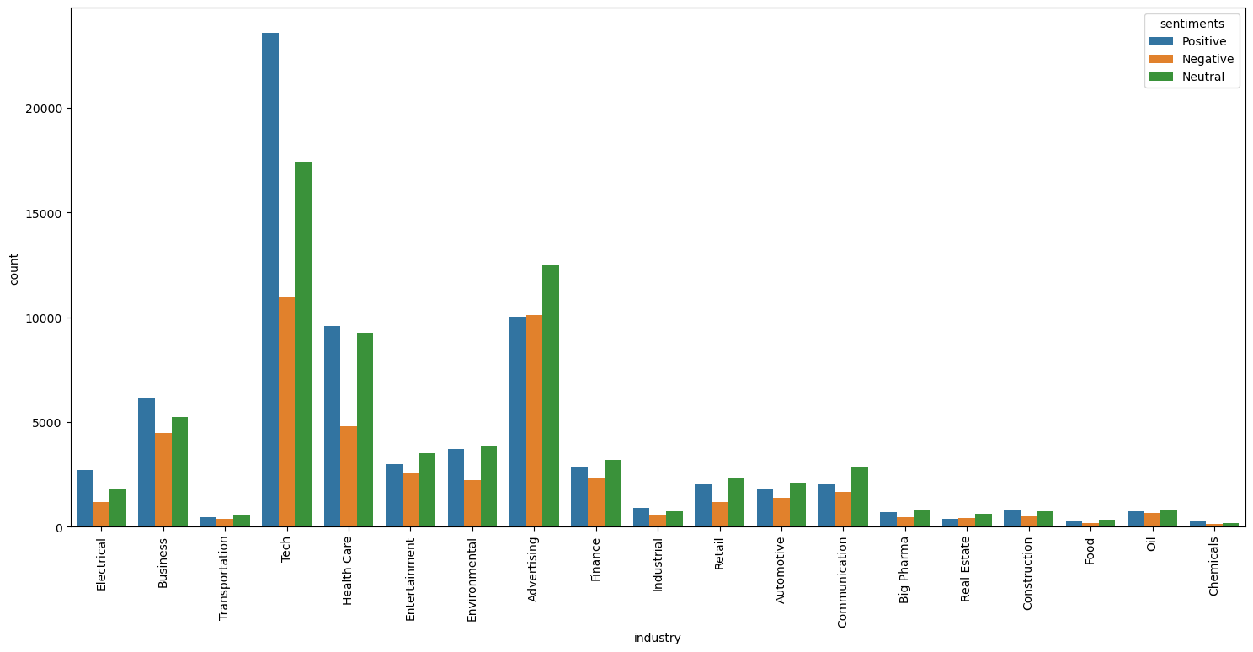
INDUSTRY IDENTIFICATION
Looking at the industry counts, we can see that industries other than the Big 4 generally have little to no use of AI. If we were to look further into the negative and positive sentiments of these industries, we can see that the major use is only in an additive manner, where it is used to add to a persons work. Neither does it transform the work nor is it heavily used. Infact most of the Aviation related news are not related to AI, but to Air India.

Slide 19
TOPIC DETECTION
For Topic Modeling, I decided to use Bertopic and not LDA due to the ease in use and time of use. While I could not generate word clouds from all topics together, I could generate hierarchies of all the topics.
Bertopic is better than other topic modelers, as it works on an embedding space to generate word similarities, which makes it much stronger than other models. It uses BERT to identify topics, and the collates them across different documents.
Bertopic works in 4 stages:
Creating the embedded documents
Dimensionality Reduction with UMAP
Clustering with HDBSCAN
After finding the dense areas with HDBSCAN, each topic is tokenized into a bag-of-words representation, which takes into account if the word appears in the document or not. After the documents belonging to a cluster are considered a unique document and TF-IDF is applied. So, for each topic, we identify the most relevant words, that should have the highest c-TF-IDF

Slide 20
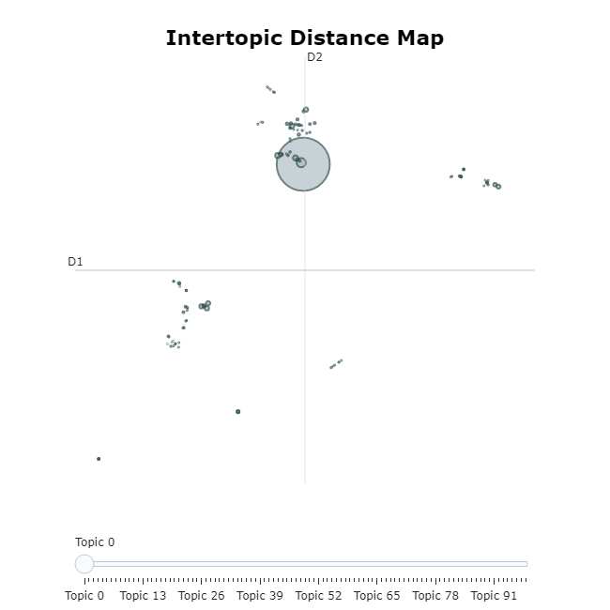
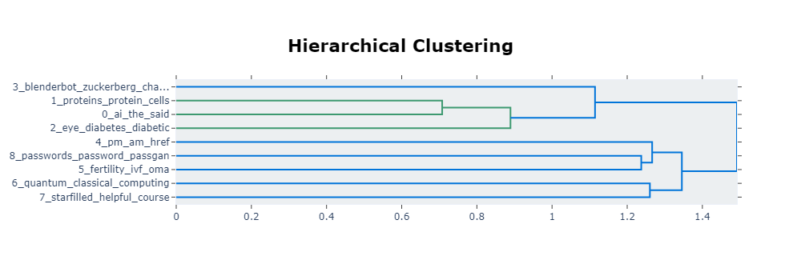
TOPIC DETECTION
While I did perform topic analysis over the entire dataset, I was not satisfied with the results, as the topics were very vague and clumped up around each other.
So I decided, to split the dataset by sentiment, and then to use the topic modeler

Slide 21
TOPIC DETECTION
NEGATIVE SENTIMENT
Within the Negative Sentiment, there are 9 main topics:
Morality of Chatbots
AI in Biotech
AI in Eye Detection
Scandals with chatbots
AI Regulations in Canada
AI In Fertility
Quantum AI
Students Complaining
AI Password cracking

Slide 22
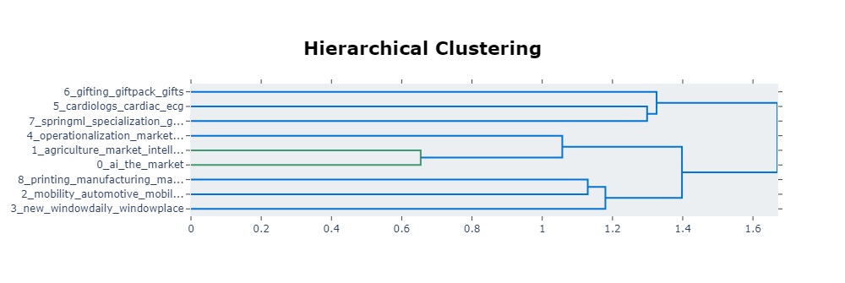
TOPIC DETECTION
NEUTRAL SENTIMENT
Within the Negative Sentiment, there are 9 main topics:
AI game changing
AI in Agriculture
Cybersecurity / EDGE AI
ChatGPI in Schools
ML growth forecast
Cardiologists and AI
GiftPack
SpringML
AI Printing Technology

Slide 23
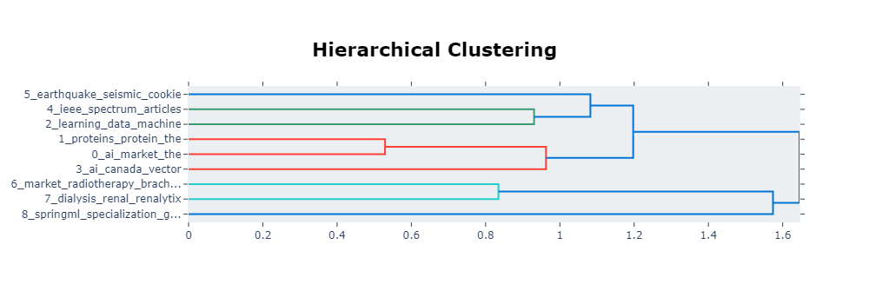
TOPIC DETECTION
POSITIVE SENTIMENT
Within the Negative Sentiment, there are 9 main topics:
AI game changing
AI in Bio
AI efficiency in companies
AI in canade
Using ChatGPT in Academia
AI’s usefulness in earthquakes detection
AI and Radiotherapy
AI and dialysis
SpringML

Slide 24
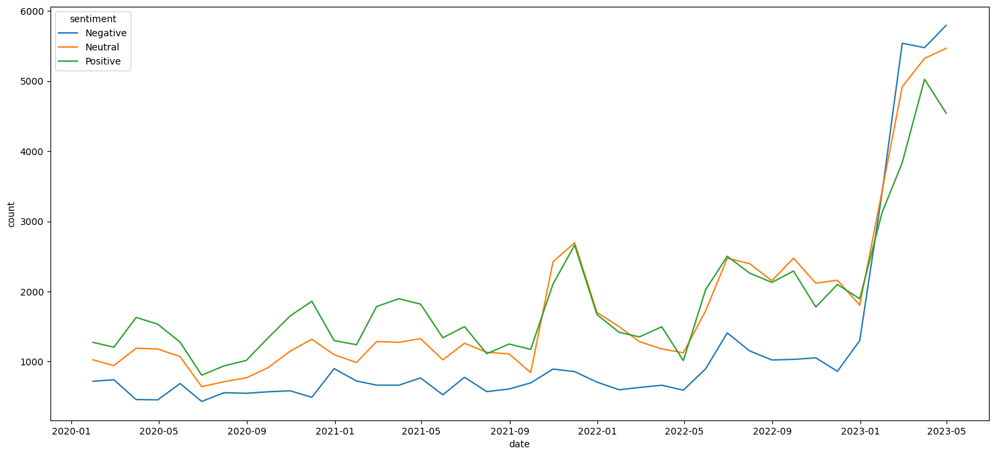
SENTIMENT OVER TIME
As we can see, the general trend for AI has been positive, until 2023, which is when ChatGPT came into the forefront. The advent of ChatGPT created a huge discourse amongst teachers and educators alike, which would explain the huge uptick in traction.

Slide 25
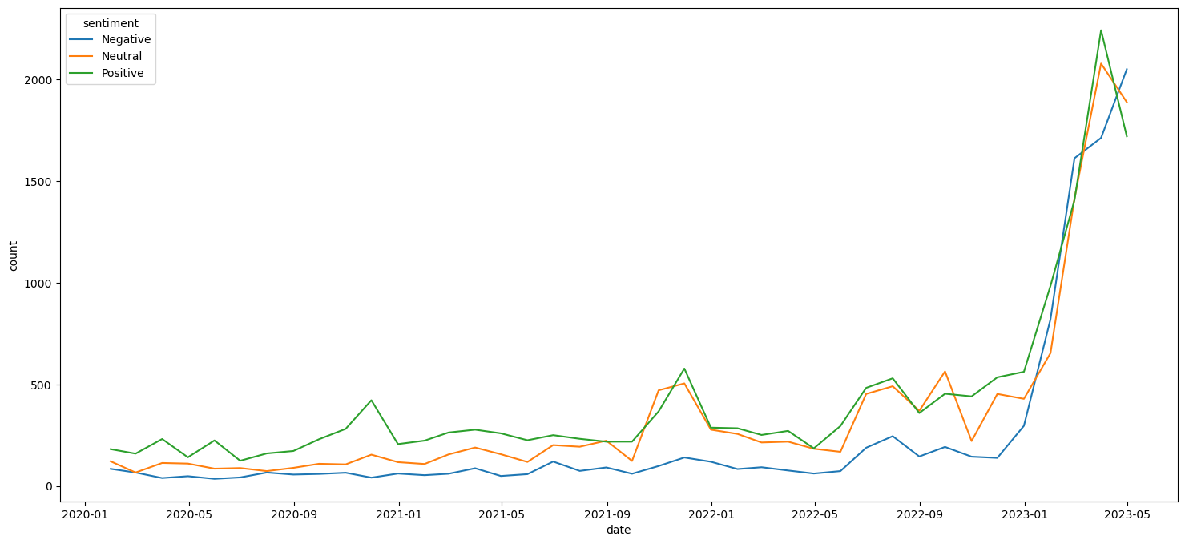
This is the sentiment over time of Generative AI
SENTIMENT OVER TIME

Slide 26
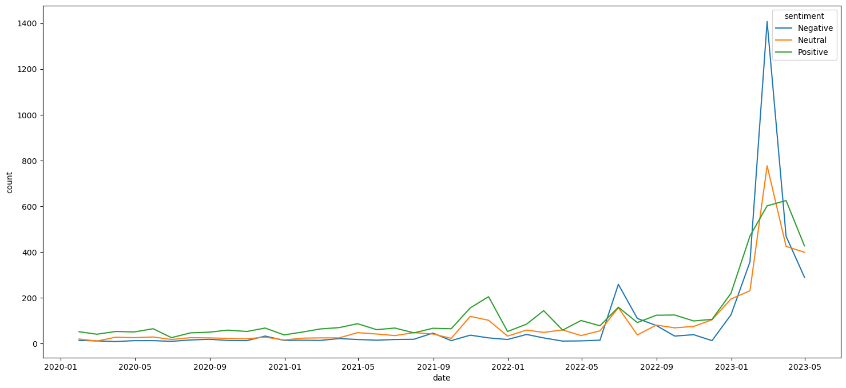
SENTIMENT OVER TIME
This is the sentiment over time of Conversational AI
As we can see, Conversational AI has always had a slightly negative sentiment, due to the various scandals by the Microsoft and google bots. Blender bot from facebook was known to have called mark Zuckerberg creepy and manipulative. All of these events have shown a negative sentiment for conversational AI

Slide 27
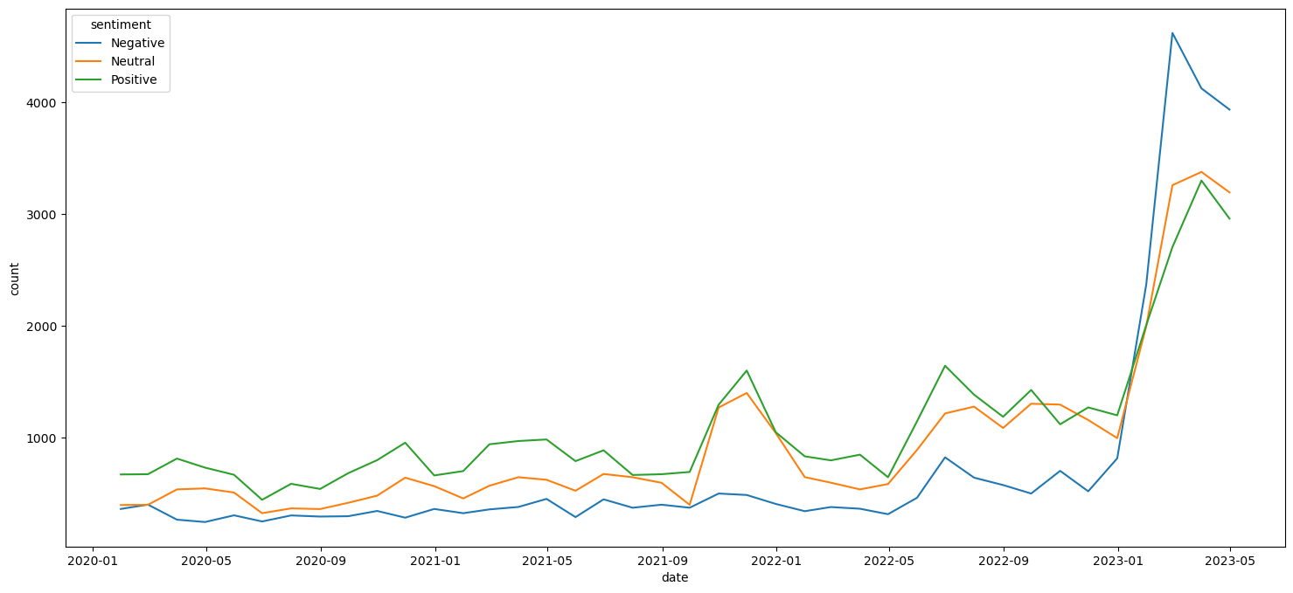
This is the sentiment over time of Automation
SENTIMENT OVER TIME

Slide 28
ENTITY IDENTIFICATION
Entity Identification was done using the NER package of Spacy and using NLTK’s NER package. But the data was never used as it contained a lot of false positives as well and kept identifying cities like Beijing as an Organization.
Instead Targeted Entity Sentiment analysis was performed using ABSA on AI and types of AI was extracted and filtered.

Slide 29
RECCOMENDATIONS
POSITIVE
NEGATIVE

Slide 30
RECCOMENDATIONS
Looking at the outputs of the topic modelling we can see that the areas AI is doing well is in areas like
Designing New Drugs
Streamlining Operations
Improving Customer Experiences
Assisting Students in Learning
Predicting geographical quakes
Agricultural Automation
Looking at the above scenarios, AI is majorly taking an assistance role in solving a problem. AI is not actively solving the problem, but merely acting as a tool in helping solve the problem, thus enriching the work.
Using AI in such a manner seems to be beneficial in general as it does not cause a loss in jobs like automation which seems to be the biggest scare factor for most people.
REFS: The positive topic analysis

Slide 31
RECCOMENDATIONS
Looking at the outputs of the topic modelling we can see that the areas AI is doing badly or has opposition to is in areas like
Morality of creators of AI ( USA is afraid of Chinese AI/Chinese Xenophobia)
Innacuracyies/ halucinations of chatbots
Curtailing creativity in students, and getting them more reliant on tools to complete homework and Cheating using ChatGPT
Chatbots making offensive remarks
Security of AI
Automation / Loss of Jobs
It is clear from the above reasons, that the loss of Jobs is the major driver of the opposition of AI, with cheating in exams being the second.
The experiments by Google,Facebook and Microsoft have also left a sour taste on the minds of people, and the new advances in AI Crypt hacking seem scary.
My recommendations for this, would be to develop and market AI more as a tool rather than as a solution to a problem. Moreover more regulations should be welcomed to curtail the activities of certain bad actors
REFS: The positive topic analysis

Slide 32
FIN

